Slide 1
How Microsoft does threat intelligence MSTIC, Githubification and GALLIUM
Tom Finney
Europe team lead - threat intelligence team
Microsoft Threat Intelligence Center

Slide 2

What to expect
I’ll tell you who MSTIC is (and what it’s not)
I’ll explore how we ‘do’ threat intelligence (but I’ll focus more on intelligence production and dissemination than its creation)
And talk about how we want to ‘do’ threat intelligence in the future
I’ll use our work on the GALLIUM activity group as a theme
I’m going to touch on John Lambert’s Githubification ideas & how we are applying this to our TI production

Slide 3
MSTIC is a TI provider for a :
a company with 148K employees that operates across the word
a major software producer
a major cloud services provider
a security solution provider
an IR practice
MSTIC is not:
a commercial TI provider (but working and sharing with partners is very important to us)
the only TI team in Microsoft
just a TI team - we ship code and detections to products
Providing world-class security detection, analytics and response to Microsoft’s cloud infrastructure and service, traditional products, devices and internal corporate resources.

Slide 4
H
hydrogen
1
He
helium
2
Li
lithium
3
Be
beryllium
4
B
boron
5
C
carbon
6
N
nitrogen
7
O
oxygen
8
F
fluorine
9
Ne
neon
10
Na
sodium
11
Mg
magnesium
12
Al
aluminium
13
Si
silicon
14
15
P
phosphorous
S
sulphur
16
Cl
chlorine
17
Ar
argon
18
K
potassium
19
Ca
calcium
20
Sc
scandium
21
Ti
titanium
22
V
vanadium
23
Cr
chromium
24
Mn
manganese
25
Fe
iron
26
Co
cobalt
27
Ni
nickel
28
Cu
copper
29
Zn
zinc
30
Ga
galium
31
Ge
geramanium
32
33
As
arsenic
Se
selenium
34
Br
bromine
35
Kr
krypton
36
We are threat-focused
We track nation state threats
Over 110 groups known to us
Over 70 full-fledged Activity Groups
Rb
rubidium
37
Sr
strontium
38
Y
yttrium
39
Zr
zirconium
40
Nb
niobium
41
Mo
molybdenum
42
Tc
technetium
43
Ru
ruthenium
44
Rh
rhodium
45
Pd
palladium
46
Ag
silver
47
Cd
cadminium
48
In
indium
49
Sn
tin
50
51
Sb
antimoney
Te
tellurium
52
I
iodine
53
Xe
xenon
54
Cs
caesium
55
Ba
barium
56
Hf
hafnium
72
Ta
tantalum
73
W
tungsten
74
Re
rhenium
74
Os
osminium
76
Ir
iridium
77
Pt
platinum
78
Au
gold
79
Hg
mercury
80
Tl
thallium
81
Pb
lead
82
83
Bi
bismuth
Po
polonium
84
At
astatine
85
Rn
radon
86
Rf
rutherfordium
112
104
Db
dubnium
105
Sg
seaborgium
106
Bh
bohrium
107
Hs
hassium
108
Mt
meitnerium
109
Ds
darmstadtium
110
Rg
goentgenium
111
Cn
copernicium
Nh
nihonium
113
Fl
flerovium
114
Mc
moscovium
115
Lv
livermorium
116
117
Ts
tennessine
Og
oganesson
Fr
francium
118
Fr
francium
87
Ra
radium
Ra
radium
88
La
lanthanum
57
Ce
cerium
58
Pr
praseodymium
59
Nd
neodymium
60
Pm
promethium
61
Sm
samarium
62
Eu
europium
63
Gd
gadolinium
64
Tb
terbium
65
Dy
dysprosium
66
Ho
holmium
67
Er
erbium
68
Tm
thulium
69
Yb
ytterbium
70
Lu
lutetium
71
Ac
actinium
89
Th
thorium
90
Pa
protactinium
91
U
uranium
92
Np
neptunium
93
Pu
plutonium
94
Am
americium
95
Cm
curium
96
Bk
berkelium
97
Cf
californium
98
Es
einsteinium
99
Fm
fermium
100
Md
mendelevium
101
No
nobelium
102
Lr
lawrencium
103

Slide 5
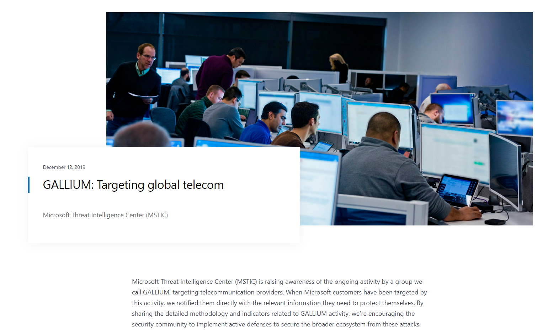
GALLIUM
Large scale operation primarily targeting CSPs
Active predominantly through 2018 to mid-2019
Exploits web-facing services to deploy web shells
Uses open source tools and modified versions of openly available malware
Relies on low cost and easy to replace infrastructure

Slide 6
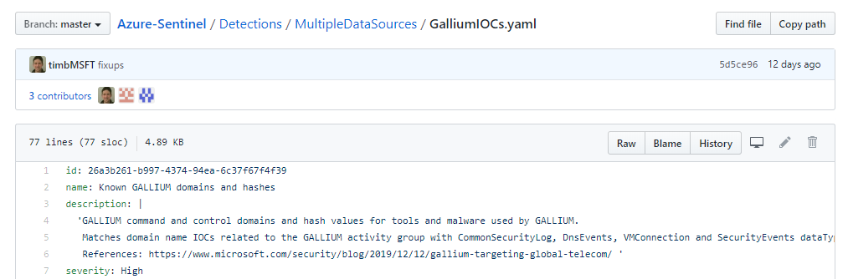
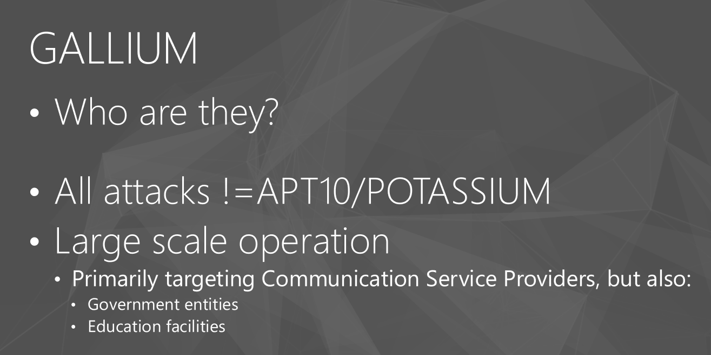
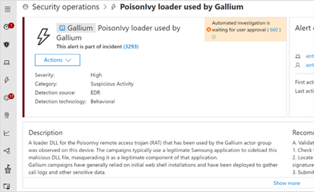
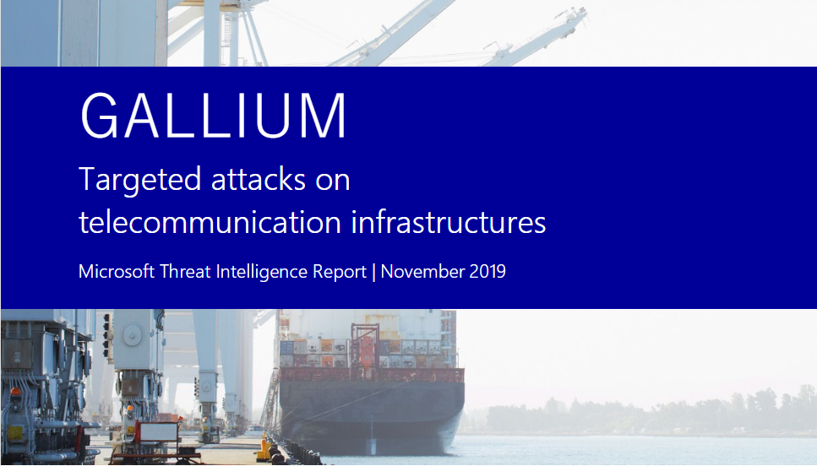
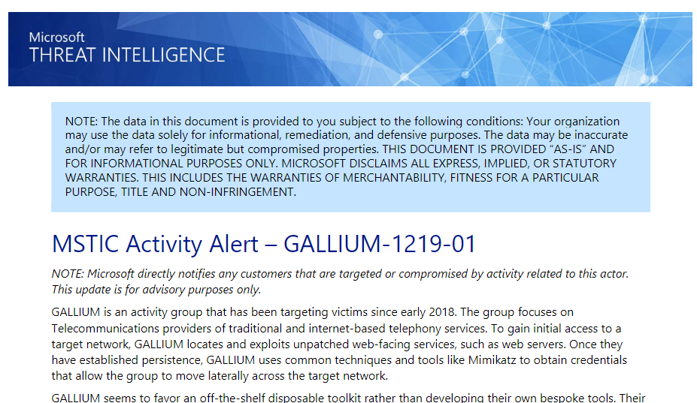


Telling the GALLIUM story

Slide 7
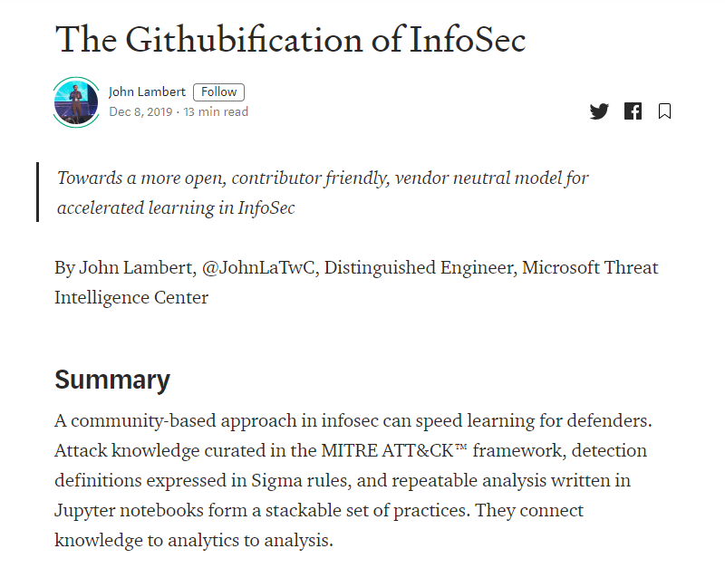
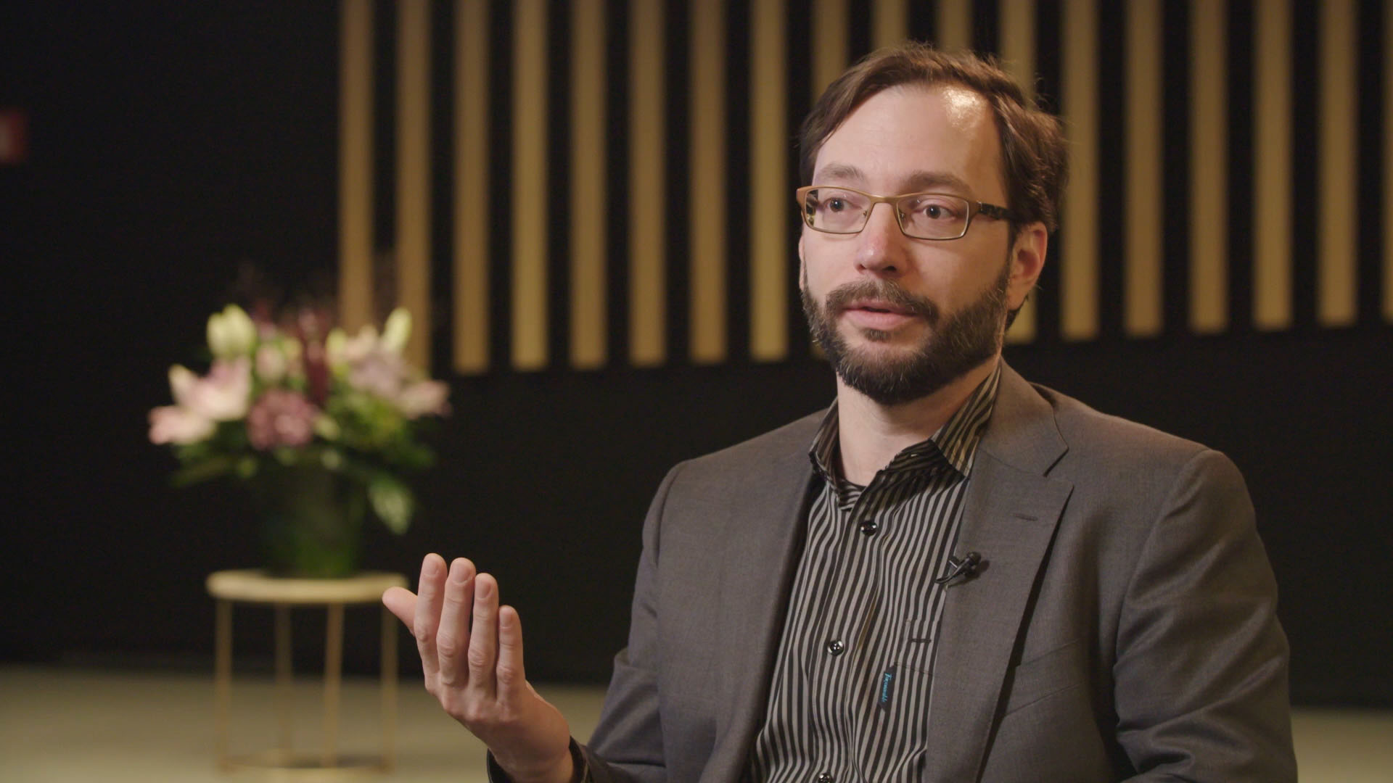
WTF is Githubification?

Slide 8
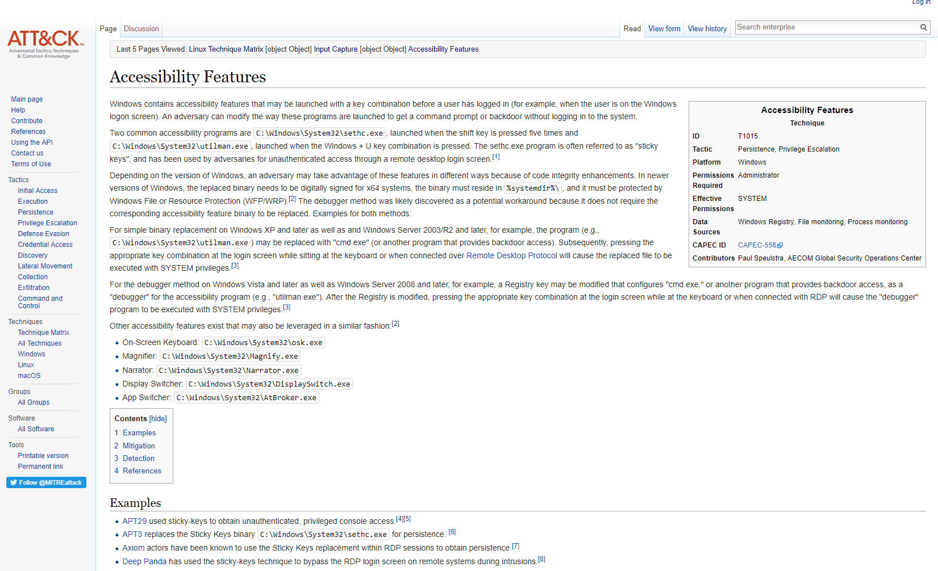

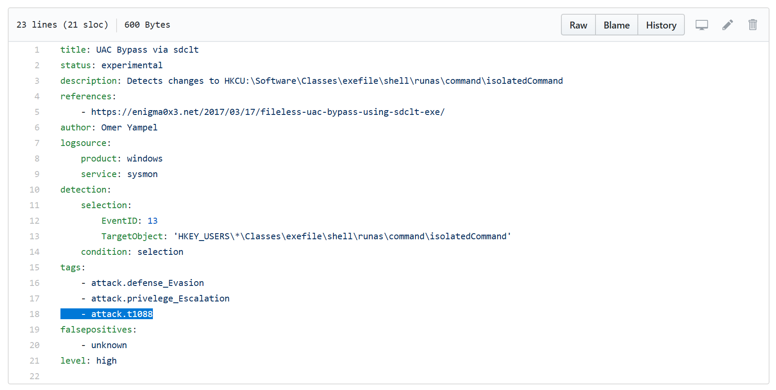

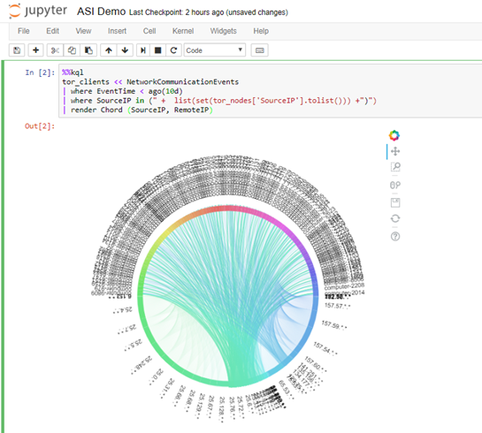

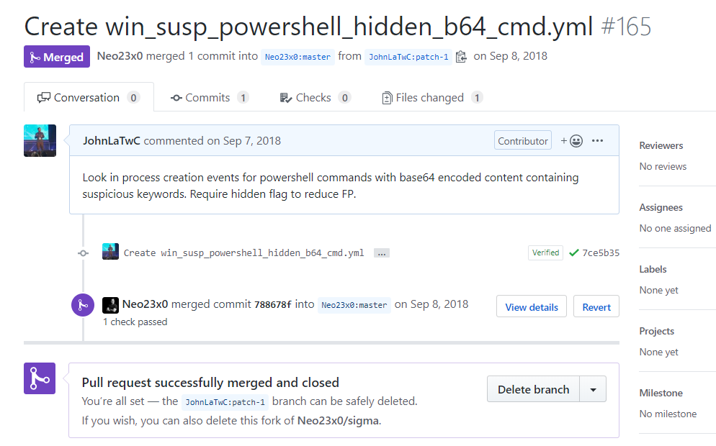


Organized Knowledge
How do understand new techniques and threats as a cohesive whole? How do you avoid each defender having to do this on their own?
Executable
Know-how
How do you translate insight into defensive action? How could you describe a new techniques and threats in a way that it is usable agnostic of environment?
Repeatable
Analysis
How do you make analysis repeatable, explainable and shareable? Can you share analytical expertise?
Promoting Community
All these elements exist because of a community. Technology is needed but learning cannot happen without teaching and teaching is built on contribution.

Slide 9
Organized Knowledge

Slide 10


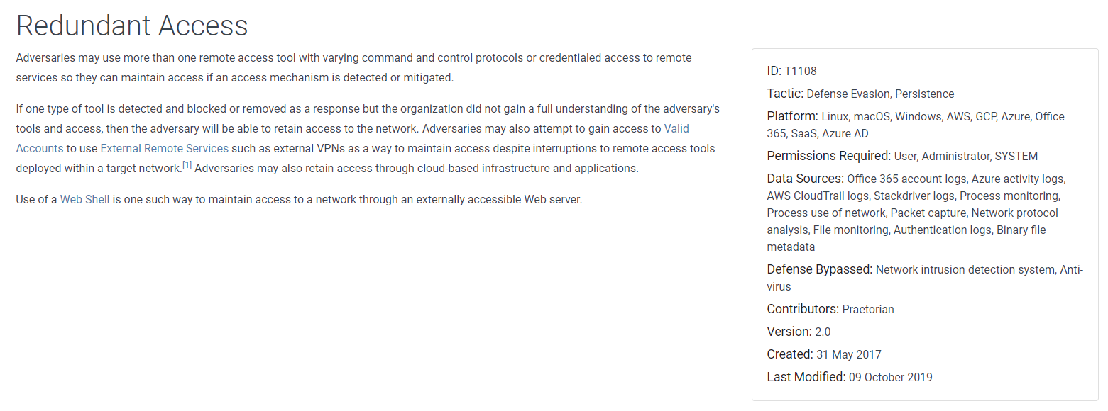
The MITRE ATT&CK™ framework is a taxonomy of attack tactics and techniques used in the wild.

Slide 11
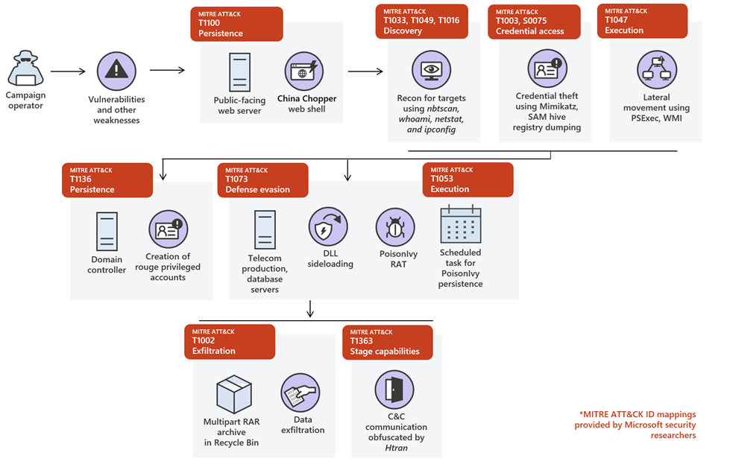
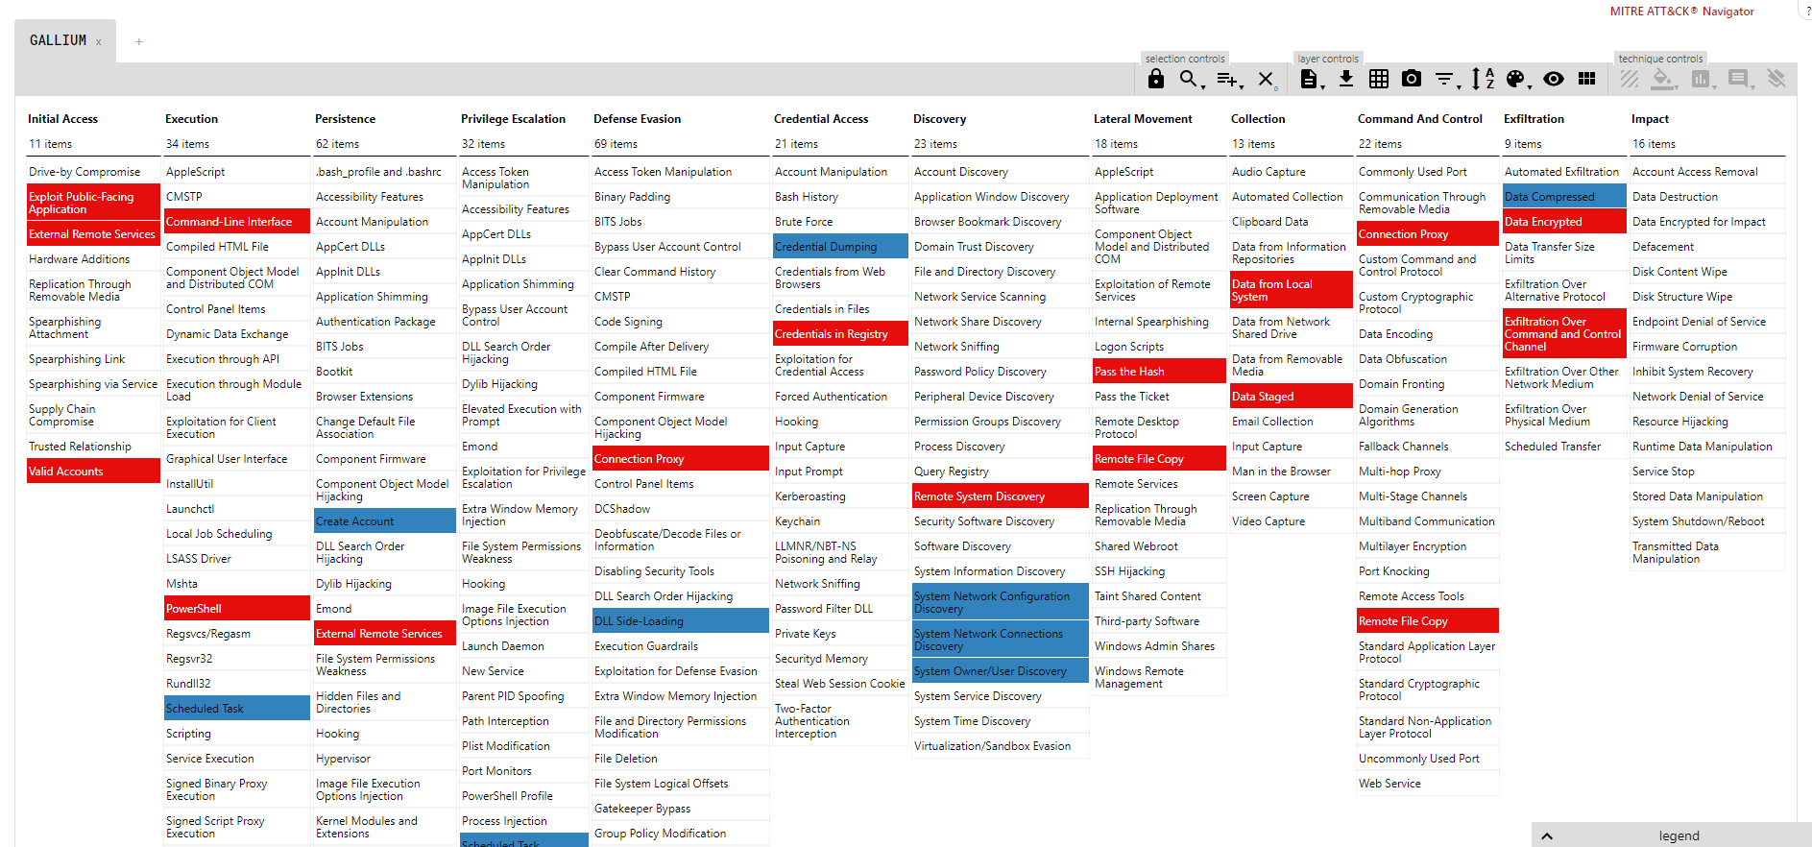
GALLIUM

Slide 12
MITRE ATT&CK simplifies learning for defenders through three principles:
It is curated. ATT&CK manages complexity by organizing techniques based on attacker objectives, grouping similar techniques together, and relating them to affected platforms.
It is contributor friendly. New techniques contributed by researchers outside of MITRE. Community contribution ensure ATT&CK documents techniques seen in actual attacks.
It is extensible. Main version for enterprise networks, but being adapted to cloud, mobile, IoT, industrial controls, and the router space.

Slide 13
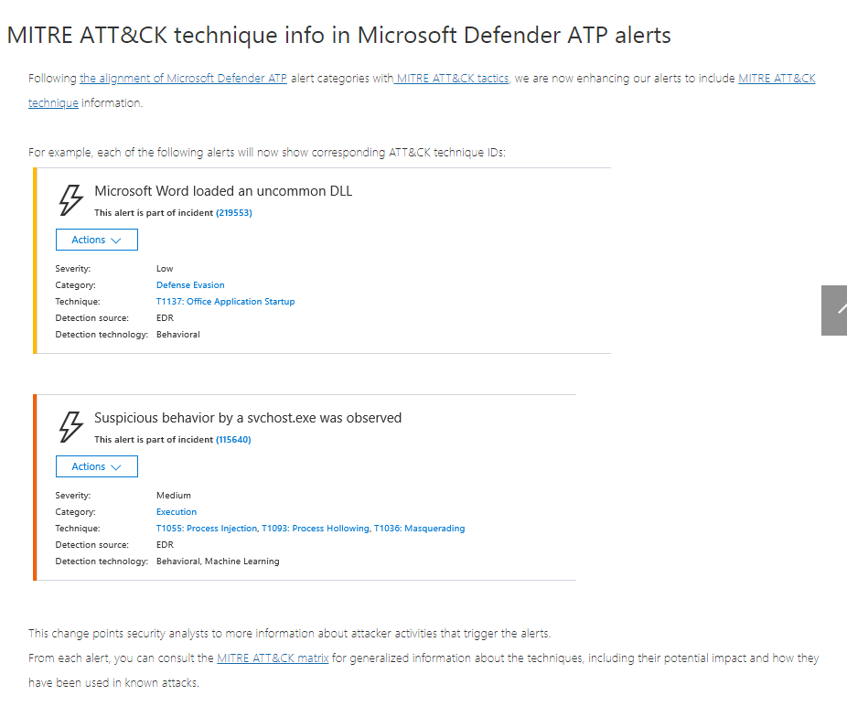
Used by many teams in Microsoft, including TI teams and Product teams
MSTIC TI moving towards systematic use in threat group intelligence production
Things we are working out:
Analyst impact
Ensuring consistency

Slide 14
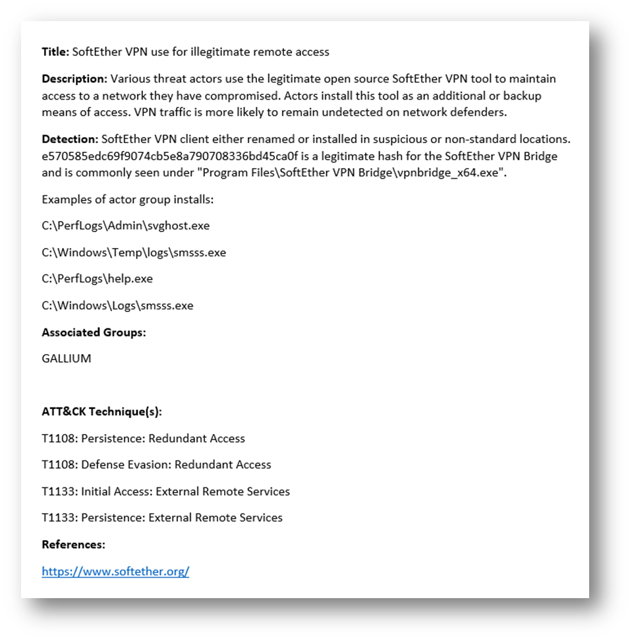
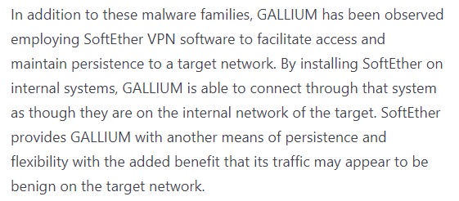
Intelligence reported at a high-level. Useful for detection writers, SOC analysts, threat hunters?
If we ‘tap’ the analytical process that led to the above at a lower level, can we produce much more useful intelligence for this community?

Slide 15
Executable Know-how

Slide 16

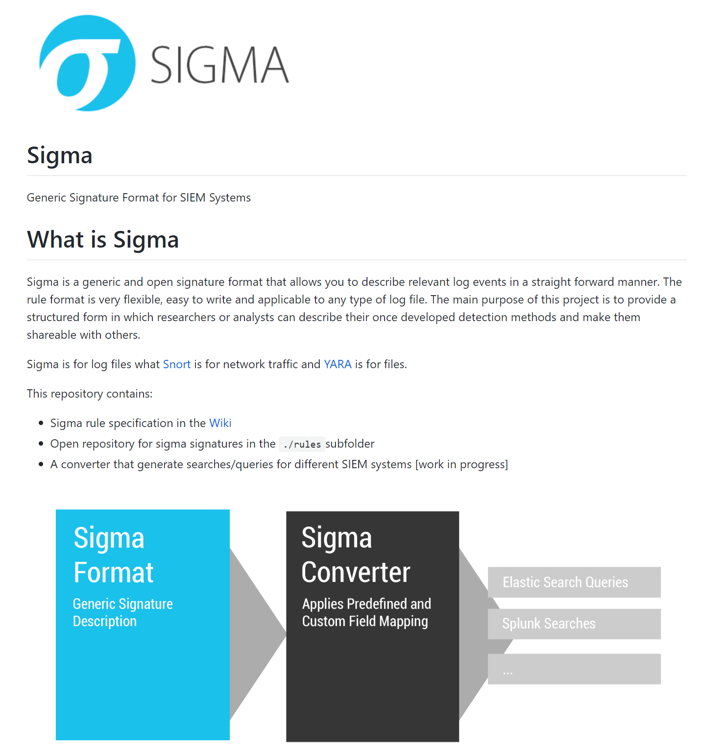
Open source generic signature format for SIEM
To logs what YARA is to files, and Snort to network traffic.
Specifies a generic way to write detections on logs.
Set of converter translates the Sigma language into popular query tools including Splunk, Elastic Search, Qradar…

Slide 17
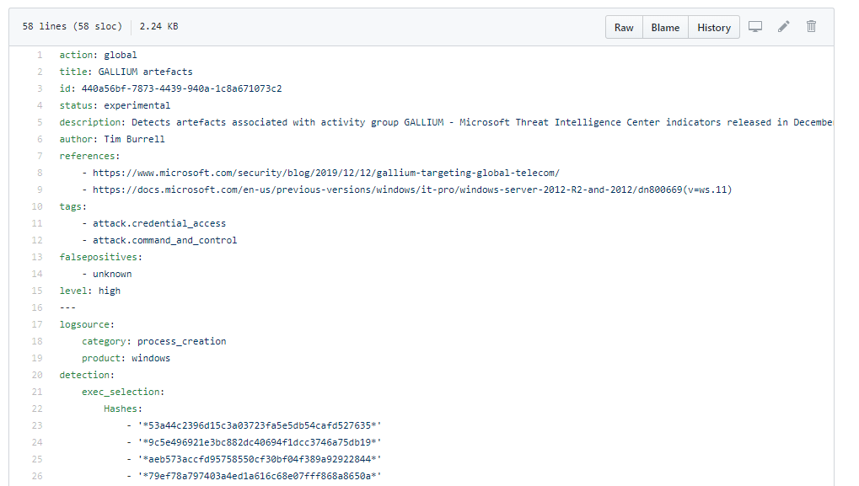
Simple rule for GALLIUM IOCs

Slide 18
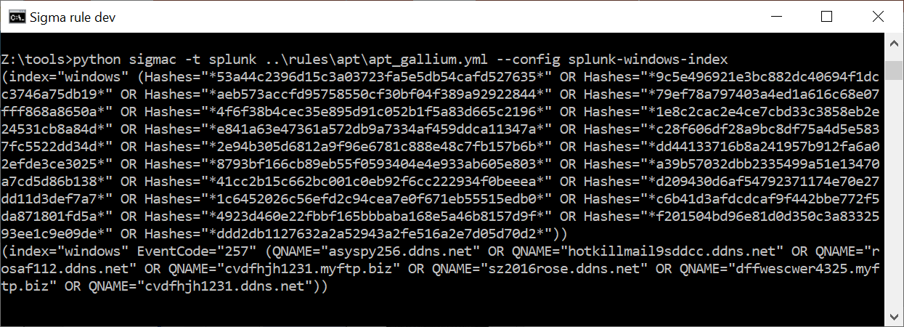
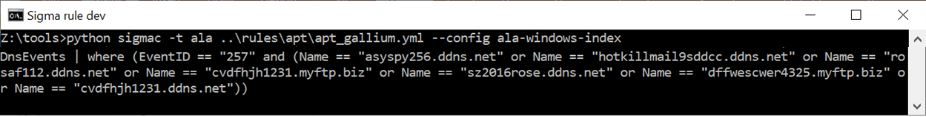
Transformed

Slide 19
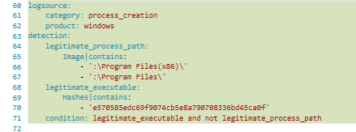
More complex example

Slide 20
Repeatable Analysis

Slide 21

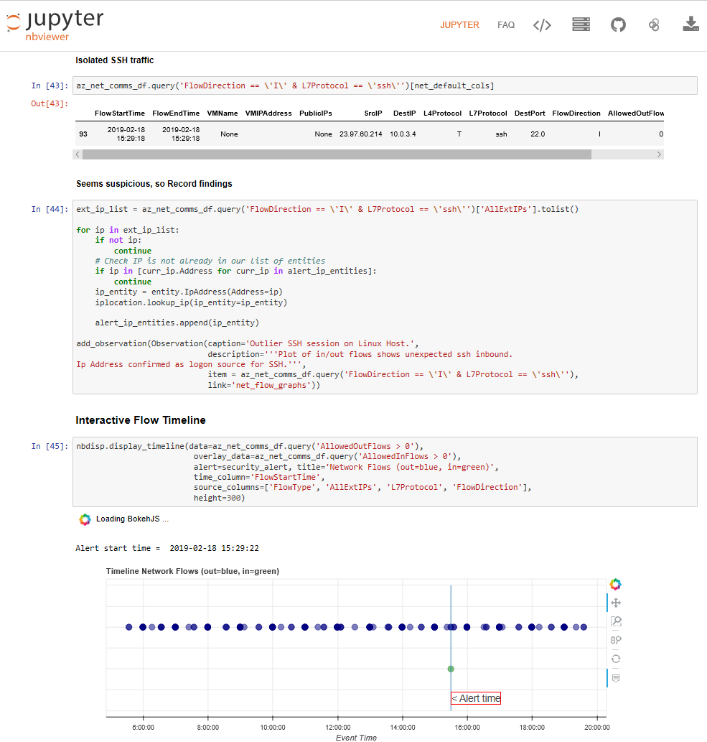
What is a Jupyter Notebook?
A Jupyter notebook is a file that combines markup, code, and data
The notebook can:
load data
Search, combine and process it
then render it
Notebooks are sharable
Not a niche technology —over 5 million on GitHub
Provides ability to execute the analysis against similar data, encapsulating expertise.

Slide 22
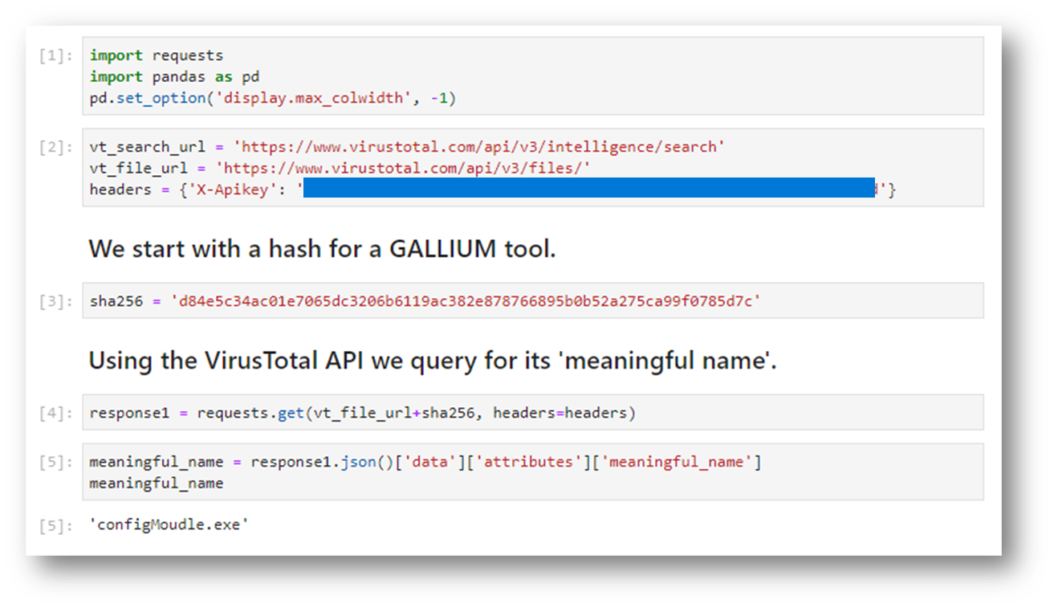
A Gallium notebook example
Code
Markup
Data

Slide 23
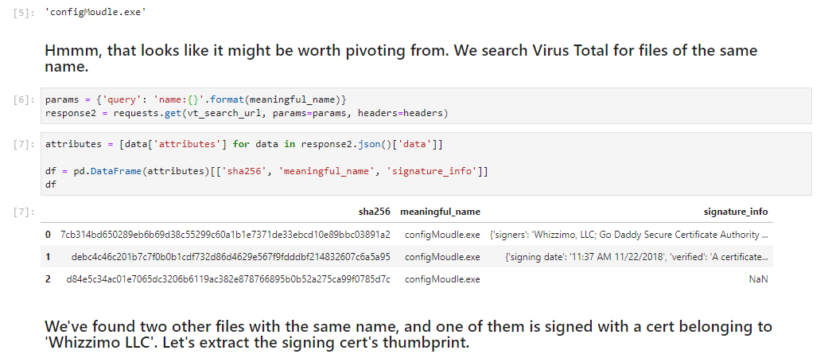
A Gallium notebook example

Slide 24
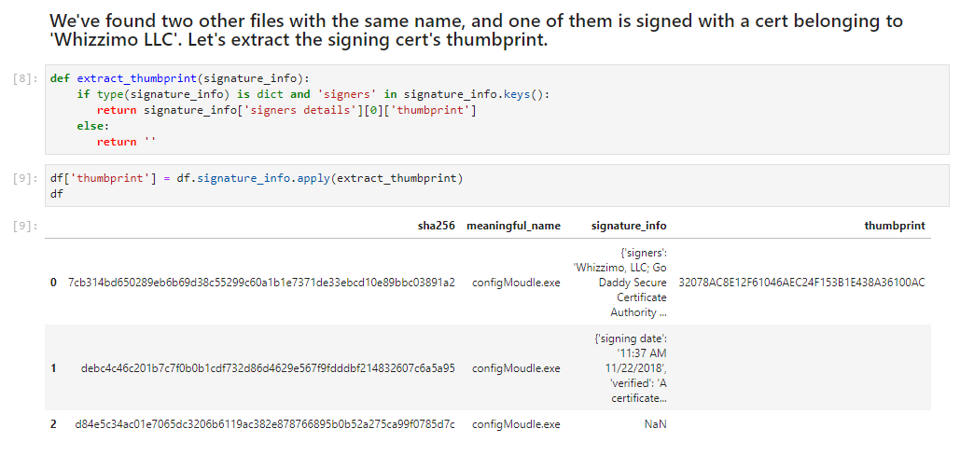
A Gallium notebook example

Slide 25
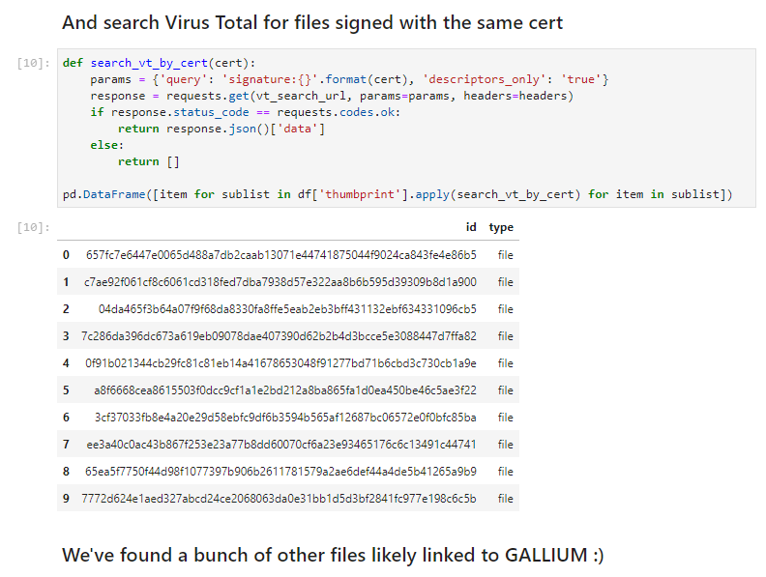
A Gallium notebook example

Slide 26
Why notebooks are great
Analysts share techniques
Provides provenance for indicators and COA
Notebooks will become records in their own right
Used as a basis for further automation of alerting
Could be used for evaluating the utility of data sources

Slide 27
Promoting Community

Slide 28

Every element of Githubification exists because of a community
Technology is needed but learning cannot happen without teaching and teaching is built on contribution
MITRE ATT&CK accepts contributions from the community and a recent update that introduced cloud-oriented techniques (including Office 365) were almost entirely sourced from the community
Florian Roth (@cyb3rops) has an open source repository of Sigma rules on GitHub. Contributing to them is simple
The Open Security Collaborative Development (OSCD) recently organized an effort to contribute Sigma rules for MITRE ATT&CK techniques. Over a hundred rules were contributed from researchers in numerous countries
https://medium.com/@johnlatwc/the-githubification-of-infosec-afbdbfaad1d1
(Or search ‘githubification’ with your favourite search engine)

Slide 29
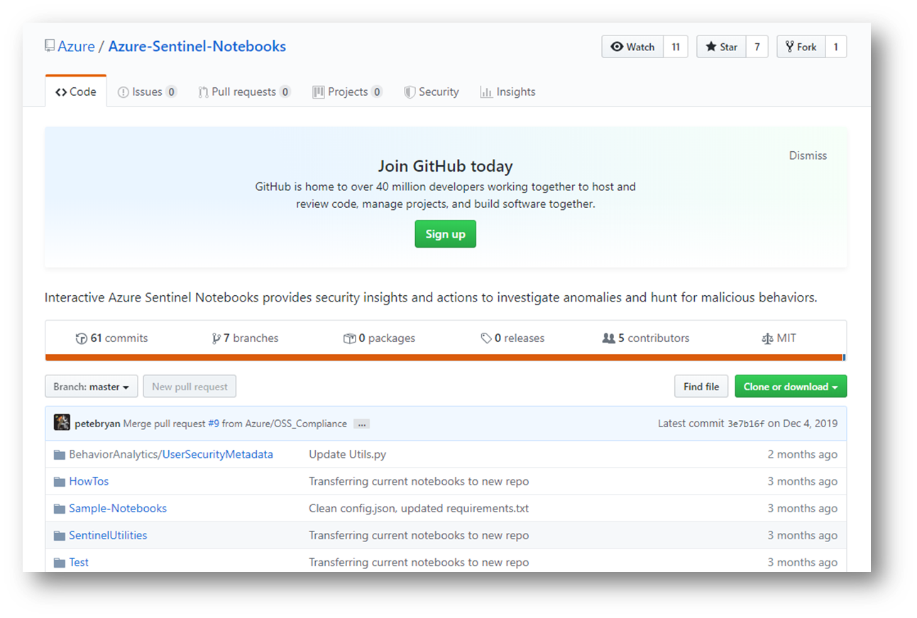
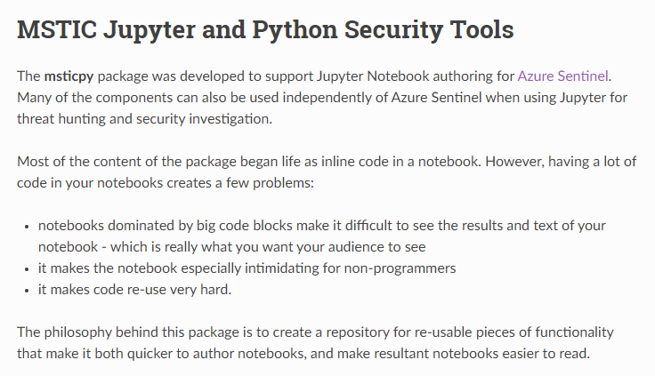
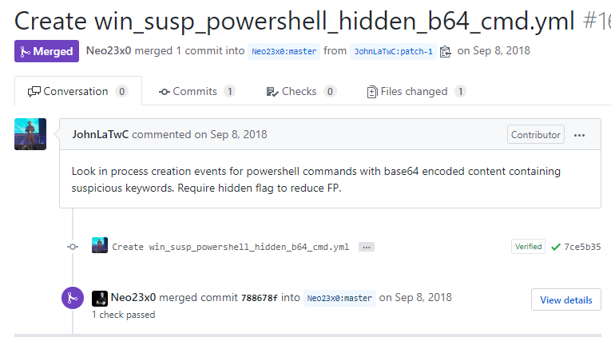
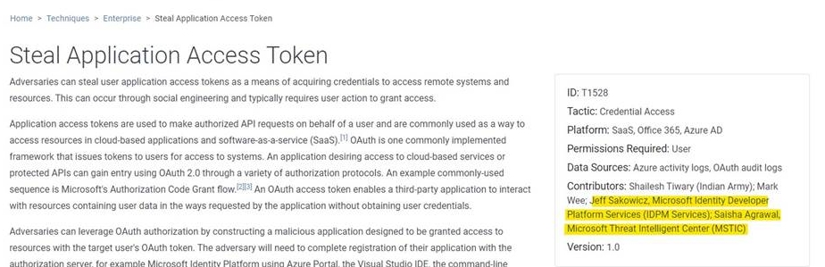
Microsoft getting ‘Githubificationed’
MSTIC contributes to MITRE ATT&CK, especially cloud techniques
We contribute Sigma rules and are looking to contribute to the next OSCD sprint
Jupyter support in Azure Sentinel and Microsoft Defender ATP and many published notebooks
MSTICpy open source library

